Slide 1
Main Roads would like to acknowledge the traditional custodians of the land on which this meeting takes place, and pay respect to their Elders both past and present and extend that respect to other Indigenous persons who are present today.

Slide 2
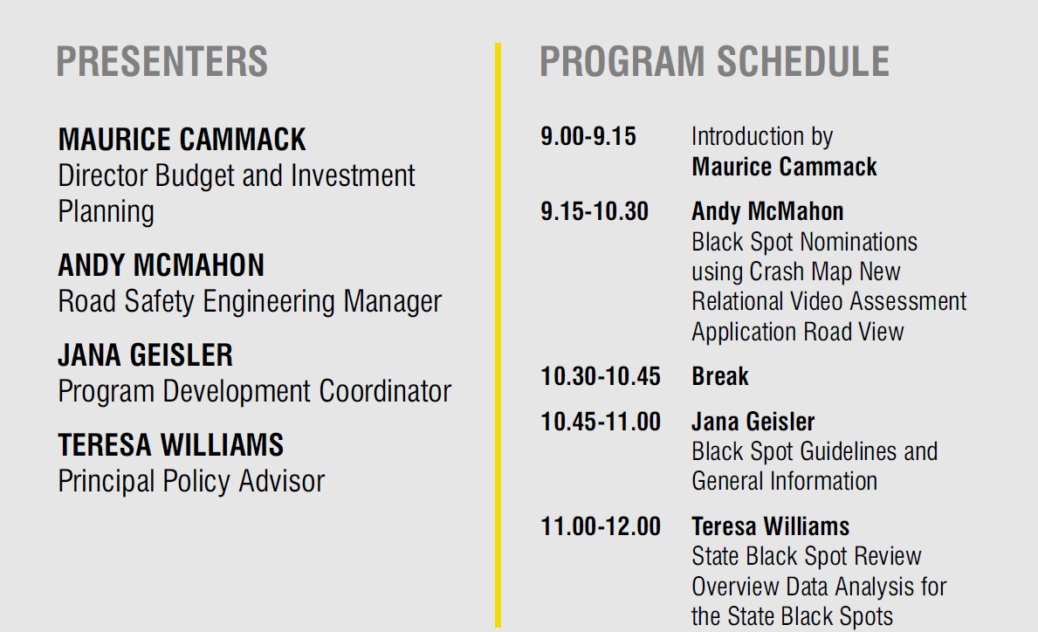

Slide 3
Crash and Inspection Based Black Spot Submissions Using Crash Map
Andy McMahon
Road Safety Engineering Manager

Slide 4
New Relational Video Assessment Application
Road View
Andy McMahon
Road Safety Engineering Manager

Slide 5
Black Spot Program Guidelines and General Information
Jana Geisler
Program Development Coordinator

Slide 6
State Black Spot Program Development and Management Guidelines
Updated in April 2022
No changes to the overall Program
Updates include transitional arrangement from CARS to Crash Map
  Variations to projects approved up to 2022-23 – CARS BCR calculations will be used
  Variations to projects approved from 2023-24 – Crash Map will be used.
  Project Completion forms required for projects up to 2022-23
  Project Completion to be entered to Crash Map for new projects from 2023-24
  Project Progress updates via email required for projects up to 2022-23
  Project Progress updates to be entered to Crash Map for new projects from 2023-24

Slide 7
2023-24 Timetable
April 2022 – Call for submissions
8 July 2022 – Metropolitan and Regional submissions close
July to October 2022 – Assessment of submissions
November to December 2022 – Preparation of recommended program
January to April 2023 – Review and recommendation
May 2023 – Program approval
30 June 2024 – Final expenditure for the 2023-24 program

Slide 8
State funded Black Spot Program Review
Teresa Williams
Principal Policy Advisor

Slide 9

Background
To complement the federally funded Black Spot Program, which was introduced during the mid-1990s, Western Australia (WA) implemented a State funded Black Spot Program.
The State funded program was designed prior to WA’s adoption of the
Safe System for road safety. Regular feedback from stakeholders suggests areas where improvements to the program may be possible.
Questions posed regarding the State Black Spot (SBS) program included:
does the SBS continue to facilitate investment in sites so as to improve road safety outcomes;
is the SBS application process appropriate, effective and efficient;
has the passage of time and the delivery of other road safety programs
impacted on the relevance of the SBS; and
is the SBS the optimal way of achieving the intended road safety
improvements with the funding provided and effort required for applications?
Notes:
The objectives of the state programme are stated in the State Black Spot Programme Development and Management Guidelines as:
“aimed at further improving road safety across Western Australia thereby reducing the significant trauma and suffering of crash victims and their loved ones” and
“to consolidate the partnership between the State and Local Governments in ensuring the community is provided with a road system which is safe for all road users, including drivers, motorcycle riders, pedestrians and cyclists.”
State Black Spot Programme Development and Management Guidelines, March 2020, https://www.mainroads.wa.gov.au/globalassets/technical-commercial/road-safety/black-spot-program/state-black-spot-program-development-and-management-guidelines.pdf
A review of the SBS, including consultation with primary stakeholders, was conducted during the first half of 2021. The objective of the review was to determine the extent to which the current SBS is relevant and/or fit for purpose to achieve road safety outcomes and is administered with minimal administrative burden.
For the purposes of this review:
‘relevant’ means appropriate and effective for achieving reductions in road trauma or avoiding future road trauma given the current operating environment, other programmes and road safety efforts; and
‘fit for purpose’ is explained as being that the programme is achieving and will continue to achieve what it was intended to do in relation to reducing or avoiding road trauma.

Slide 10
Review process
Twenty-five articles and book chapters, produced 2008 to 2020, were included in the review
The approach taken for the review included:
an exploration of literature regarding similar programs nationally, internationally and
existing material regarding the SBS;
targeted stakeholder input; and
analysis of SBS nomination data for the
six-year period 2016/17 to 2021/22.
Findings collated into themes: administration; funding; governance and accountability; program criteria; and stakeholder and customer focus.
Stakeholders consulted:
Regional Road Group (RRG) participants;
WALGA representative;
individuals with specific knowledge or experience relevant to road safety
What is:
good and should be retained;
good but needs to be done differently;
done and should stop; and
not done but should be incorporated.
Notes:
The questionnaire and interview discussions focussed on what is:
good and should be retained (effectiveness);
good but needs to be done differently (relevant but not effective / efficiency);
done and should stop (including ‘is the programme still relevant’ / ineffective / inefficient); and
not done but should be incorporated (relevance / effectiveness / inefficient);
regarding the SBS.
Analysis of SBS nomination data will be provided as a separate presentation today.

Slide 11
Overview of Review Findings
WA evaluations
Meuleners and others 2008
Chow and others 2017
Limited to evaluation of Benefit Cost Ratio projects
International and National literature support Black Spot
programs; however, offer options and recommendations
that vary from the State Black Spot (SBS) program.
Previous evaluations of the SBS found it is achieving road trauma reductions.
Key stakeholders support the program and the SBS is considered effective for fostering a positive relationship between Main Roads and local governments.
The SBS is still relevant; however, there are opportunities to improve the extent to which it is fit for purpose.
2018 Austroads report:
“although black spot programs do a good job of fixing problems in specific locations with poor crash records,
the majority of crash sites are widely dispersed across the road network.”
Notes:
The literature review included twenty-seven items; comprising articles, editorials, book chapters and reports. With the exception of one item, all materials were from 2008 to 2021. This timeframe was selected as existing literature reviews, which covered the period prior to 2008, were encompassed.
Two items were evaluations of WA’s programme (Meuleners et al 2008, Chow et al 2017). Both evaluations of WA’s programme found it to be effective, with the 2008 study finding a reduction in ‘all’ reported crash rate of 15% and the 2017 study finding a reduction of 17.5% in all reported crashes. The latter also found a reduction of 30.3% in casualty crashes and 22.0% in killed and seriously injured crashes.
Both studies conclude the programme is effective. This is consistent with findings for other jurisdictions.
Austroads report (Durdin et al, 2018) quote: and identifies that a step-change in road safety is unlikely just by investing in black spot programmes as black spots are a small proportion of safety problems at a network level. The report advocates moving beyond black spot analysis to an approach that takes into account road characteristics and “applies [a] whole-of-network approach to predict likely locations of future crashes”.
Other points in literature included:
moving beyond treatment of sites based on crash histories or a risk assessment;
design to manage risk, and staging implementation along lengths of road, for example staged clearing of roadside obstacles, installing safety treatments and lowering speeds on high traffic roads within set area; and
matters regarding accountability, monitoring and reporting.

Slide 12

Diving into the findings - administration
The SBS administration, particularly the application process was the issue most commonly and broadly commented upon by stakeholders.
Online nomination, monitoring and reporting has been requested, with improvements in the data and system functionality available for local governments to use.
Stakeholders requested greater support from MRWA for local governments without the relevant expertise.
Literature reviewed provided variations, such as longer term and area/region wide planning that could be considered.
The administration of the SBS is an area of focus for change.
The Crash Map Tool has been well received by stakeholders and there is appetite for further development
Notes:
Stakeholder statements regarding ‘Administration’ were the most common (n39) and were made for every question.
Consistency within the statements and calls for administration to have full online functionality.
The SBS is considered a relevant programme. The extent to which it is considered the optimal way of achieving road safety improvements with the funding provided and effort required is questioned by some stakeholders.
The most commonly occurring subject regarding administration commented upon by stakeholders for what needs to be done differently, or refined, was the Crash Map Tool (13% of ‘do differently’ comments) and treatment options available through the programme (13%). Comments included improvements for the process using the tool and benefits of the tool.
The focus of both topics, Crash Map Tool and treatment options, were stakeholders wanting more value adding functionality as a part of the system and greater breadth of options available both through the system and funded through the programme.
Suggestions included changes to when and how project planning occurs and funding arrangements. Challenges for local governments, such as access to expertise and competing for funding based on BCRs, were often cited as the reason for suggestions made regarding changing administration and criteria requirements.
Approval processes for vegetation and utilities, and boundary adjustments were noted as needing to improve.

Slide 13
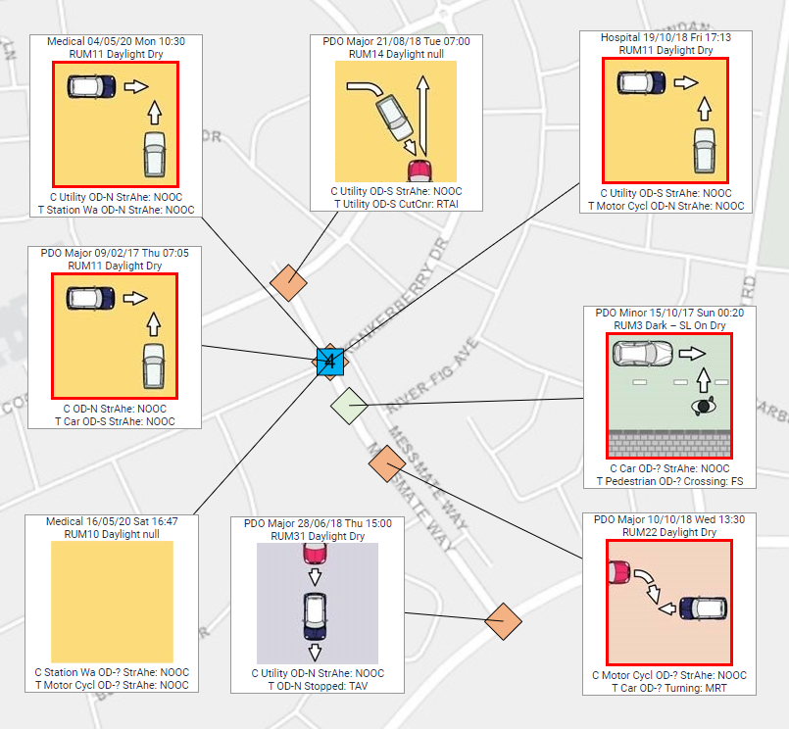
Current action - administration
The MRWA Crash Map Tool continues to be developed,
including the following:
mapping and crash monitoring tools;
road safety engineering resources;
crash cluster queries, crash queries, crash reports and
collision diagrams;
expanded treatment selection options and economic appraisal;
Black Spot crash-based and inspection-based applications; with
reviewed Crash Reduction Factors; and
revised life of treatments, for example increasing the life of roundabouts.
Notes:
At the April 2021 meeting of the State Road Funds to Local Government Advisory Committee (SAC) it was announced that a guidance note will be prepared to distribute to local authorities to assist work out how to improve their programmes, including the SBS.
National Road Safety Action Plan 2021-2025 states a commitment to
“build capacity across decision makers and all levels of government by developing
training and education programs, with particular focus on regional and remote
local government capacity”.
Amongst other opportunities, road safety education and training has or does include the:
Monash University Accident Research Centre (MUARC) Road Safety Management Leadership Programme delivered in WA during 2018 and 2019 with a focus on local government;
Institute of Public Works Engineers Association (IPWEA) Road Safety Auditing and Road Safety Engineering courses; and
University of Western Australia (UWA) Road Safety Research Centre current development of road safety training.

Slide 14
Dive into the findings - funding
Funding trends for metropolitan and regional areas are different in relation to basis of nomination, BCR or Audit, and numbers of nominations seeking funding.
Stakeholders support ongoing funding through the SBS;
however, variations to the funding approach were suggested.
Some stakeholders cited instances where nominations may be for projects not wholly focused on providing road safety benefits.
Literature which discussed funding primarily recommended:
securing stable funding;
shifting from retrospective Black Spot re-engineering to a prospective staged delivery for corridors or precincts, including speed adjustments; and
reducing motorcycle crash risk through various changes including funding treatments and maintenance of high-risk routes.
Trends regarding basis of nomination, BCR or Audit, and numbers of nominations seeking funding provide insight into changes that may be required to improve ‘fitness for purpose’.
Notes:
An April 2021 report to the SAC included information about trends and funding status of programmes, including the SBS. The relevant SBS information included:
for the four-years 2016/17 to 2019/20 160 projects had delays, including 28 project withdrawals;
withdrawn projects accounted for nearly $2.8 m of funding carried forward from years prior to withdrawal; and
67 delayed projects occurred within the final 20% grant claim stage with delays attributed to third party works, predominantly street lighting, budget adjustments with late funding increase requests and/or late work-in-progress construction.
Nomination data analysis will be elaborated on in another presentation today.

Slide 15

Current action - funding
The State Road Funds to Local Government Agreement (Agreement) 2018/19 to 2022/23 states that the State Road Funds to Local Government Advisory Committee (SAC) is responsible for overarching policy and procedures for administration of the agreement and RRGs are responsible for developing regional specific policies and procedures within the framework set.
RRGs recommendations to the SAC may include the SBS.
The National Road Safety Strategy includes commitments to:
apply safe system principles for investments, including best practice speed management;
targeted programs to reduce road trauma on key state routes; and
invest in local government road networks through Network Wide Safety Plans for local council areas.
Notes:
The 2021/22 State Budget Papers include funding for Black Spots for all years of the Forward Estimates, 2022/23 to 2024/25.
There is no suggestion or consideration being given to reducing the SBS funding.

Slide 16
Findings – governance and accountability
Governance and administration arrangement for ensuring road safety outcomes of funded projects as an inherent part of the program.
Many stakeholders made statements regarding effectiveness of governance
arrangements.
Statements included:
Some nominations may not be fully investigated for appropriate counter measures,
Some nominations for projects not wholly focused on road safety benefits,
Question requirements for safety auditing of projects and project reporting requirement.
Understanding effectiveness and appropriate governance was identified in literature as enabling the development of a road safety culture, and reporting as a requirement for ensuring real attention is brought to all safety concerns, defining responsibilities, decision-making and auditing.
The diverse range of views regarding the extent and appropriateness of the current accountability regime requires careful consideration about amending the SBS requirements.
Notes:
Stakeholder comments regarding effectiveness (13% of all comments) included escalating or increasing the regularity and depth of evaluations of treatments, projects, and programme effectiveness.
Other comments included the use of ‘place value metrics’, such as monitoring and evaluating treatments that add value and protection for vulnerable road users.
Accountability was the focus of 15% of the comments made regarding what should cease. Comments included stopping funds being used for work that should be funded through maintenance and rehabilitation budgets.
A few stakeholders reflected upon administrative burden, most statements indicated an appetite for improved monitoring, reporting and sharing information regarding projects and outcomes.
One comment identified audits at various stages of projects being an unnecessary cost.
Other comments regarding what should be done differently covered a broad range of issues such as more staging of projects, improving transparency and accountability, including reporting treatment effectiveness. Within ‘other comments’ made by stakeholders, reporting to stakeholders, such as programme metrics, was requested.
An arrangement, the Safer Roads Advisory Committee, was noted in the stakeholder input as not being disbanded but has not met for some years. The Terms of Reference include:
“monitor and provide advice and strategic direction on Safer Roads strategies and funding (including State and National Black Spot Programs and the Safer Roads Programs) to ensure they effectively contribute to the performance indicators in Towards Zero; [and]
evaluate and report on the effectiveness of various road safety programs (for example Black Spot and Safer Roads Program)”.

Slide 17
Current action – governance and accountability
The SBS Program Development and Management Guidelines include:
independent auditing of sites, financial claims, project variations;
evaluation to identify overall safety performance of the program; and
project completion reports require information focussed on project delivery without road safety outcomes being noted.
State Road Funds to Local Government Agreement
(Agreement) 2018/19 to 2022/23 includes a
requirement for Key Performance Indicators (KPIs)
to include road safety.
The National road safety strategy includes a commitment
to a comprehensive performance monitoring and reporting regime.
National Strategy
All levels of government are to accept “accountability and responsibility for the road safety performance of their networks in accordance with Safe System principles”
Notes:
The SBS Program Development and Management Guidelines (Guidelines) include:
MRWA arranges independent auditing of sites, financial claims, project variations and Guidelines compliance;
MRWA arranges an independent evaluation to identify the actual safety performance of the programme;
information sharing is encouraged between local government and MRWA; and
project completion reports require information focussed on project delivery without road safety outcomes noted.
State Road Funds to Local Government Agreement includes a requirement for Key Performance Indicators (KPIs) to include road safety.
The KPIs are for monitoring with no incentives or penalties attached to KPI results.
An annual report is provided to the SAC and RRGs.
Specific to road safety, the Agreement commits MRWA, WALGA and RRGs to establishing a Road Safety Management System.
The WA road safety strategy 2020 to 2030 states the road safety targets can only be achieved with governments and others by all working with a shared responsibility, with local and state government working in partnership.
The National road safety strategy includes a commitment to an agreed set of national road safety targets and action priorities; supported by a comprehensive performance monitoring and reporting regime. Clear governance arrangements with transparency and accountability will be established in relation to the National Strategy.

Slide 18

Findings – program criteria
Based on 2019 data, just over 5,000 sites in Western Australia have a crash history that meet either the Australian Government Black Spot Program or the SBS crash criteria. Of these, more than 3,270 specifically qualify for the SBS.
Relating to BCRs, statements ranged from lack of access to expertise, challenges to achieve the required BCR, a lack of sufficient crash history and what costs and/or benefits are included or not in the calculation.
Comments from regional stakeholders identified the geographic spread and dispersed incidence of crashes as a contributing factor to difficulties achieving the required BCR.
Amendments to the program will need to be clear about objectives and principles in order to respond to the diverse views regarding any possible criteria refinements.
Comment supported by 2018 Austroads report

Slide 19
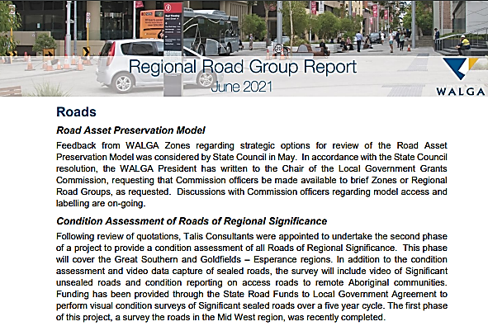
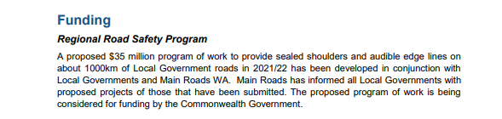
Current action – program criteria
The SBS Program Development and Management Guidelines provide eligibility criteria, including BCR ≥ 1.0, crash history requirements and provision for RSA based projects.
The State Road Funds to Local Government Agreement 2018/19 to 2022/23 states funding is to “target improving the safety of roads with a proven crash history or high-risk locations with the likelihood of crashes occurring”.
Consultants have been appointed by WALGA to perform a condition assessment of all Roads of Regional Significance. Funding has been provided through the State Road Funds to Local Government Agreement to perform these visual condition surveys over a five-year cycle.
Notes:
In addition to the traditional road safety programmes:
Regionally focused multi-million dollar programme of work to provide sealed shoulders and audible edge lines on about 1,000 km of Local Government roads developed in conjunction with Local Governments and Main Roads WA. Main Roads has been working with Local Governments regarding proposed projects.
Main Roads WA have been working collaboratively with local governments for the Urban Road Safety Programme to implement low cost road safety treatments on an area wide basis to reduce the likelihood of fatal and serious injury crashes. Pilot projects have been completed and now the programme is expanding.
I particularly like “Road Diet Treatments”; reconfiguring and optimisation of road space in order to service all road users. Where the existing road space exceeds vehicle traffic demand, and there is a mix of road users, including cyclists. Redistribution of space to suit the needs of the area.
Crash and speed reduction is achieved through lane narrowing, separation of turning vehicles, and the presence of active transport modes, changing the character and purpose of the street.

Slide 20
Findings – stakeholder relationships and customer focus
Stakeholders indicate the SBS is achieving the objective of consolidating the road safety partnership between state and local governments for the safety of vehicle occupants.
Challenges for local governments such as expertise, funding and ability
to achieve the required BCR were highlighted by the stakeholder input.
Opportunity for development of a road safety culture and to foster a better understanding of road use risks (literature)
Stakeholders identify the SBS as being beneficial to stakeholder management, such as informing residents regarding safety improvements. Some suggestions more needs to done for road users such as pedestrians and cyclists.
Literature identifies an opportunity for the SBS to commence contributing to fostering a shared responsibility and the development of a road safety culture.
Alignment with the Safe System requested, including underlying principles of road safety being a shared responsibility and including components other than infrastructure, such as travel speed.
Notes:
Road safety countermeasures were the main topic of four items within the literature review which included reinforcement that sound knowledge of accident causation and correction is required by Road Safety Auditors, and that all road users and conditions should be considered in designs.
Challenges identified by stakeholders regarding administration, expertise, achieving the required BCR and local government funding available to contribute to the process, may be contributing to the number of SBS nominations made each year and clarifies requests for more support from MRWA.
Stakeholder comments stating perceived BCR limitations included the lack of capacity and capability of local governments, particularly regional areas. Based on the stakeholder input and context for many WA local governments, it is unlikely the breadth and depth of knowledge researchers suggest is necessarily is accessible by all local governments.
Literature identifies an opportunity for the SBS to commence contributing to fostering a shared responsibility and the development of a road safety culture.
Some literature calls for greater participation in safety efforts by non-road safety personnel and to foster a better understanding of road use risks.

Slide 21

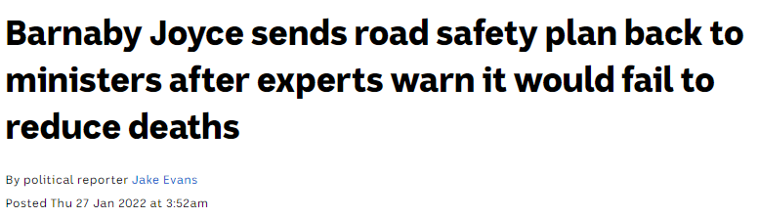
Current action – stakeholder relationships and customer focus
The State Road Funds to Local Government Agreement 2018/19 to 2022/23 states a commitment to promote and apply the Safe System approach for road safety.
The November 2021 draft of the National Road Safety Action Plan 2021-2025 included:
assisting local government to build capacity, including investing in planning and design;
developing policies by working with governments, organisations and community; and
specific actions such as build strengthened institutional management functions to manage for results, build capacity across decision makers at all levels of government.

Slide 22
Findings – treatment options and span
Suggestion made for the annual Black Spot Information session to include case studies and presentations about effective treatments.
Stakeholder comments regarding treatment options/countermeasures were the second most commonly occurring.
Some suggestions to change from a ‘spot’ program to an area or zone approach for treatments. Articles within the literature indicate that treating corridors or taking a whole-of-network approach is more effective than treating ‘spots’.
The effectiveness and range of treatments were focus areas for stakeholders. Predominately about increasing range of treatments, gaining better insight into the effectiveness of treatments, and sharing information across all local governments.
Based on stakeholder views: increasing treatment options and the inclusion of other ‘leavers’, demonstrating Safe System principles though non-infrastructure treatments such as lower speeds, needs to be considered.
Notes:
Specific statements were made regarding inclusion of Local Area Traffic Management initiatives, including speed setting as one of the treatments, moving to a corridor or zone approach rather than spots, and some opposing views regarding basing treatments on the safe system approach.
Within the literature review, some articles advocate for moving beyond treatment of sites based on crash histories or a risk assessment. They propose expanding proactive approaches into design to manage risk, and staging implementation along road corridors. For example, staged clearing of roadside obstacles, installing safety treatments and lowering speeds within a 50 km radius of a city.

Slide 23

Current action – treatment options and span
Black spots can be at an intersection, mid-block or short sections of road and black lengths are lengths of road three or more kilometres long.
In addition to Black Spot, current programs include Regional Road Safety Program, Metropolitan Intersection Crashes Program and Urban Low Cost Intersection Treatments Program.
National Road Safety Strategy:
  implement Movement and Place to provide safe road environment for pedestrians and cyclists;
  deliver measurable improvements in safety through infrastructure funding at all government levels;
  governments to embed and deliver road safety into their business as usual; and
  deliver systematic safety improvements on a road corridor basis against baseline assessment network safety plans.
Notes:
The Australian National Road Safety Strategy 2011-2020 identified introducing a black spot/length programme for motorcycle riders ‘in the future’. This was never implemented.
The November draft of the National Road Safety Action Plan 2021-2025 included specific measures such as proportion of central business districts and town centres that adopt a Movement and Plan model with speed limits of ≤ 40 km/h.
MRWA delivers the Regional Road Safety Improvement Programme which installs audible edge lines and seals road shoulders and the Metropolitan Intersection Crash Program which targets high risk intersections with a high crash rate .
MRWA has implemented an urban road safety programme focussed on a series of innovative, low cost, safety treatments for local roads, including mini-roundabouts; low cost roundabouts, raised safety platforms and uncontrolled pedestrian crossings.

Slide 24
Summation
Matters which could be considered for amendment include the following:
  improve the return on investment through what is funded and/or economies of scale;
  revisit the concept of a ‘black spot’ to consider lengths of roads or area treatments;
  increase alignment with the Safe System; and
  revisit the project nomination and
  selection process.
Issue most commonly and broadly commented upon by stakeholder: the application process. Fully online functionality for nomination, monitoring and reporting has been requested, with improvements in the data and functionality available for local governments to use. Further, stakeholders requested greater support for local governments without the relevant expertise.
Consider in the context of related administration, performance requirements ………. for example, National Road Safety Strategy
Notes:
Based on this review, other matters which could be considered include the following.
Improve the return on investment. This may be in relation to reducing potential cost shifting for maintenance or non-road safety enhancements; or increasing economies of scale for projects or treatments. Some stakeholders identified cost shifting practices.
Revisit the concept of a ‘black spot’. Research identifies that treating areas or road lengths rather than ‘spots’ can provide greater road safety performance. Planning a range of treatments to implement incrementally for a road length or region has been recommended by some authors. Also, treatments specifically for non-vehicle occupants such as pedestrians or cyclists, or over-represented groups like motorcyclists is required if all road users are to be safe.
Increase alignment with the Safe System. The Safe System principles include all components of the system working together and compensating for failures in any other component. The SBS focuses on one component, roads and roadside infrastructure. As noted by some stakeholders, safe speed is a significant factor within the infrastructure environment and could be a lever used to improve road safety outcomes as a part of SBS projects.
Revisit nomination and selection process. There is a broad spectrum of views regarding the nomination and site selection process. Variations include MRWA providing a list of priority sites and possible treatments for projects each year based on crash data, grouping of sites for lengths or precincts, establishing treatment approaches like the Low Cost Intersection Treatment scheme for mass action, to moving away from data driven priorities to evidence gleaned through Road Safety Audits (RSA).

Slide 25
Questions & Thank you

Slide 26
Black Spot Data Analysis
Some of the discoveries as a part of the Review of the State Funded Black Spot Programme
Teresa Williams
Principal Policy Advisor

Slide 27

Background
State Black Spot (SBS) Review
Project nomination data for the six-year period 2016/17 to 2020/21 was collated to identify the nature and trends of submissions for the SBS.
The data was reviewed in alignment with the SBS funding allocation approach. This being four funding areas; with $10 million per annum allocated equally between rural/remote and the metropolitan area, between state and local roads.
Analysis regarding rural/remote local roads, rural/remote state roads, metropolitan local roads, and metropolitan state roads.
Actual funding and proportions of funding are State funds only, exclusive of local government contributions.
Some variations in the nature of the data exists due to what is collected
or not for particular project proposals.

Slide 28
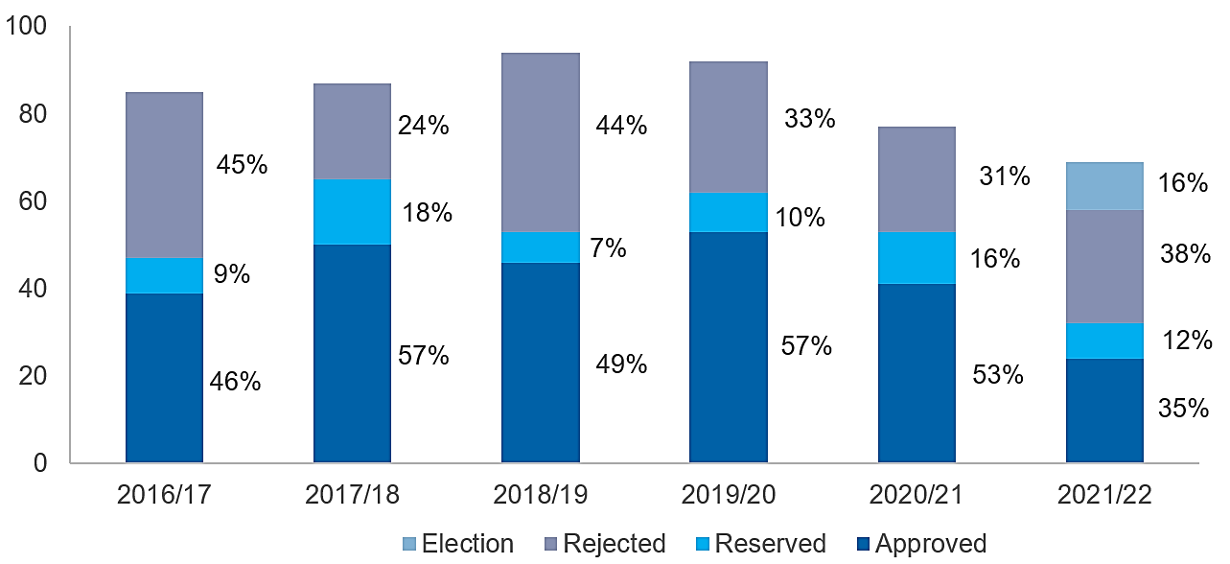
Metropolitan local roads – nomination numbers and outcomes
The number of nominations slightly increased from 85 for 2016/17 to 94 for 2018/19, then decreased to 69 for 2021/22.
For the years 2016/17 to 2020/21 approximately half the nominations made each year were approved whilst 35% of nominations for 2021/22 were approved.
It is worth noting that 16% of nominations for 2021/22 were identified and funded as election commitments.

Slide 29
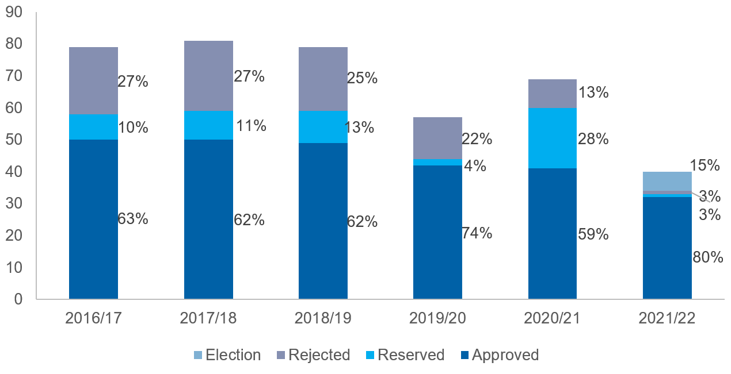
Rural and remote local roads – nomination numbers and outcomes
The number of nominations fluctuates around 80 for
2016/17 to 2018/19, then it decreases to 40 for 2021/22.
The number of approved
projects declined from 50 for 2016/17 to 32 in 2021/22.
It is worth noting that 15%
of nominations for 2021/22
were identified and funded
as election commitments.
Notes:
The South West region is the most populated region outside of Perth.
For each year, overall, between 14% to 29% of total regional nominations are from the South West.
Compared to other regional areas, nominations from the South West have a higher proportion of approved.
This will be further explained as we progress through an explanation of the data.

Slide 30
Metropolitan state roads – nomination numbers
Between 2016/17 to 2020/21 the number of approved projects decreased from 13 to 7 for the metropolitan area.
There are annual fluctuations; however, the overall trend line indicates that ‘13’ is a high for state road nominations in the metropolitan area.
It is worth noting the total numbers of approved projects for state roads are less than those for local roads, although funding allocations between state roads and local roads are equivalent.

Slide 31
Regional state roads – nomination numbers
Between 2016/17 to 2020/21 the number of approved projects increased from 5 to 16 for regional areas then declined to 11.
As illustrated, there are annual fluctuations with the overall trend line showing an increase in regional state road nominations.
The total numbers of approved projects for state roads each year are less than those for local roads. The scale of projects each year also varies.

Slide 32

Metropolitan local roads – basis of nomination
For each year, the first (left) bar represents Benefit Cost Ratio (BCR) nominations and the second (right) bar Road Safety Audit (RSA) nominations.
In the metropolitan area approximately 70% of all nominations are assessed with BCR, except for 2021/22 when it was 57%.
Between 50% to 60% of BCR nominations are approved; while the percentage of RSA approved nominations is approximately 40% to 50% for 2016/17 to 2020/21.
Consistently more BCR than RSA nominations are rejected, whilst RSA nominations are more numerous than BCR nominations on the reserved list.

Slide 33
Metropolitan local roads – BCR vs. RSA Approvals
Consistently over 70% of approved projects are BCR based and the remaining are RSA based.

Slide 34
Metropolitan local roads – BCR vs. RSA funding
For each year, funding allocations to BCR and RSA has been about equal
with the sum of these being $5 million,
except 2020/21 with total $7 million
($4.2 million for BCR and 2.8 million for RSA)
and
2021/22 with total $5.7 million
($3.9 million for BCR and $1.8 million for RSA).

Slide 35
Regional local roads, excluding the South West
– basis of nomination
Nominations identified as BCR or RSA as approved, reserved, rejected or as an election commitment for regional areas other than the South West.
For each year, the first bar (left) represents BCR nominations and second one (right) RSA nominations. More than 80% of nominations are assessed with RSA for these regional areas each year.

Slide 36
Regional local roads, excluding the South West
– BCR vs. RSA Approvals
Consistently most projects are approved with RSA; especially 2018/19 with 84% of approved projects being assessed based on RSA.

Slide 37

Regional local roads, excluding the South West
– BCR vs. RSA funding
For all years except 2021/22, RSA projects attract more funding than BCR projects.
However, for most years the funding allocation gap between RSA and BCR projects is narrower than the gap in numbers of approved projects.
Implies that in these regional areas, costs for RSA projects tend to be lower than BCR projects.

Slide 38
Regional local roads, the South West
– basis of nomination
Comparing South West data to all other regions highlights that unlike other regions, nominations from the South West are predominantly BCR based rather than RSA based.
The proportion of BCR nominations fluctuates; however, these are always the majority ranging from 63% (5) for 2019/20 to
100% (18) for 2020/21.
Notes:
The South West data is more comparable to metropolitan nomination data.
The years 2018/19 and 2019/20 have the lowest number of nominations and project approval is almost equal for BCR and RSA nominations.

Slide 39
Regional local roads, the South West
– BCR vs. RSA approvals
Consistently, the majority of projects are approved based on BCR in South West, especially for 2020/21 when the percentage of approval
was 100% for BCR .

Slide 40

Regional local roads, the South West
– BCR vs. RSA funding
No surprise

Slide 41
Regional State roads – approved projects
Between 2016/17 to 2020/21 the trend for the number of approved projects declined for the South West whilst it remained fairly steady for other Regions.
The total number of approved projects for State roads is less than approved projects for local roads.

Slide 42
Regional State roads - funding
In regional areas, the average cost of projects in the South West and other regions is approximately $0.4 million
2020/21 was an exception with an average cost of $0.73 million for regions other than the South West.

Slide 43

Of interest – all crashes 2016-2020 by month
‘All crashes’ includes crashes that result in fatality, hospitalisation, medical treatment or property damage,
major or minor.
January and
April compared
to March, May and August ?

Slide 44
Of interest – all metropolitan crashes 2016-2020 by month
The number of metropolitan crashes dominate WA data for ‘all crashes’.
Monthly pattern is the same

Slide 45
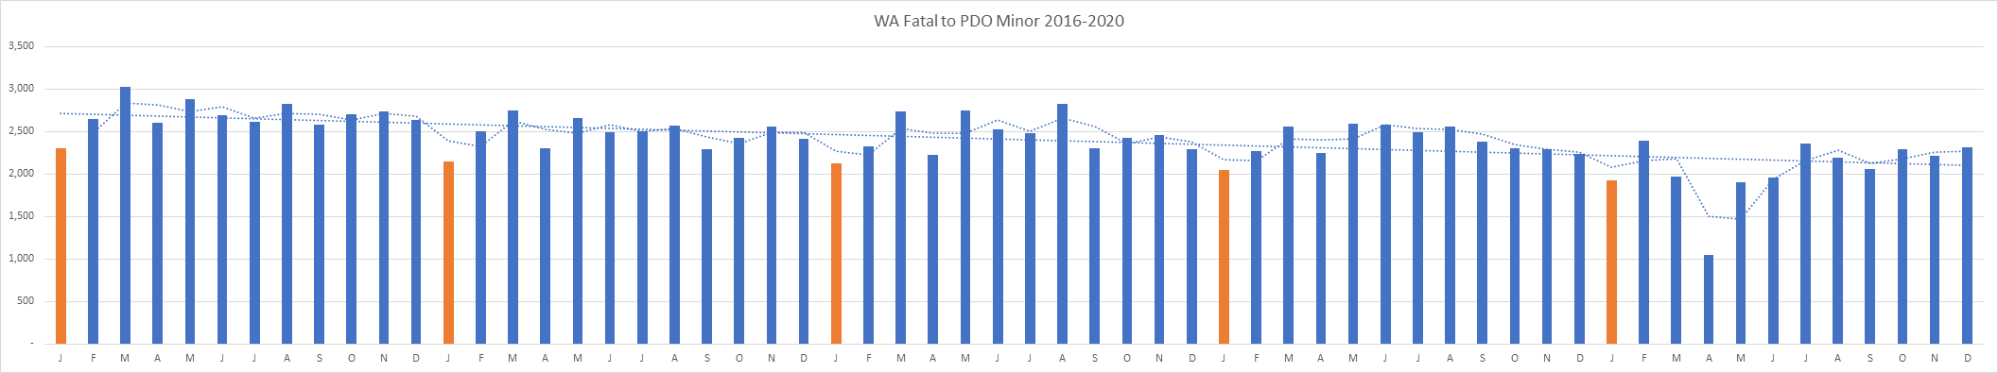
Reoccurring pattern – all crashes 2016-2020 monthly

Slide 46

Of interest – day of the week patterns
All WA
Saturday and Sunday are the lowest
‘crash days’
Monday
Saturday

Slide 47
Confirmation – fatality crashes and speed
Note groupings are not MRWA regions

Slide 48

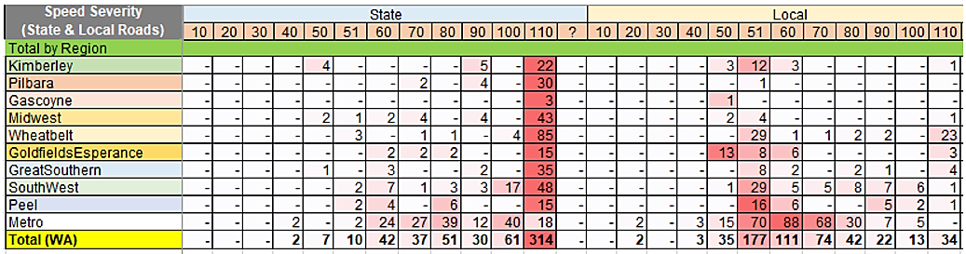
Speed – State and Local roads
51
The majority of fatalities occur on State 110 km/h roads, with 27% of these
in the Wheatbelt
Most fatalities on 110 km/h Local roads occur in the Wheatbelt
Most fatalities on Local roads occur on 50 – 80 km/h roads

Slide 49
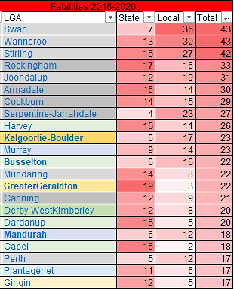
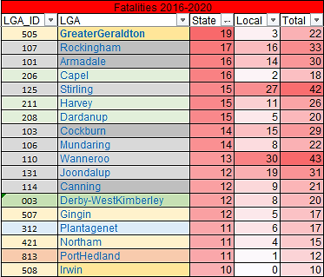

State and Local roads – something to think about
Spot
LGA
Region
Corridor
Notes:
Left side
LGAs with 17 or more fatalities on local roads are shown in descending order. There are 22 LGAs on this list.
First 8 are in the metropolitan area, all fringe or outer local governments and some in the same metropolitan region.
Right side
LGAs with 10 or more fatalities on State roads are shown in descending order. There are 18 LGAs on the list.
Greater Geraldton tops the list and outer metropolitan areas feature in the top 12 along with 3 in the South West.
What do I want you to think about?
Considering the National Road Safety Strategy:
lead indicator, share of state and territory governments and local councils with a fit-for-purpose road safety risk assessment as an investment plan for its infrastructure;
‘regional road safety’, governments at all levels will plan and implement network-wide safety improvements; and
first Action Plan will enable funding commitments to be made towards concrete and deliverable actions with safety performance indicators;
as a part of the State Black Spot Programme review, can the programme assist with the achievement of the actions and targets of the National Road Safety Strategy?

Slide 50
Thankyou

