Slide 1
Heavy Vehicle Services
Operator’s Information Session – Changes to WAHVA Documentation
April 2023

Slide 2
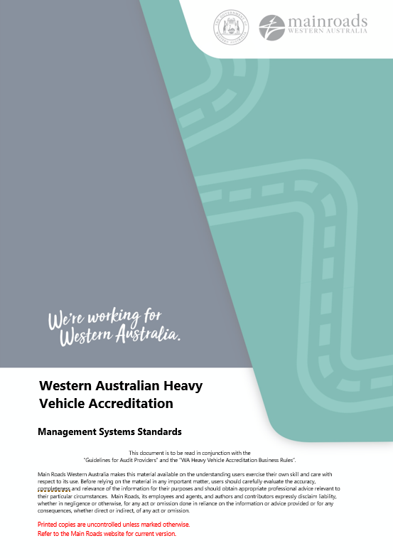
Welcome
Housekeeping
HVS Overview
Consultant vs Auditor
Revised Documentation
Q & A Session

Slide 3
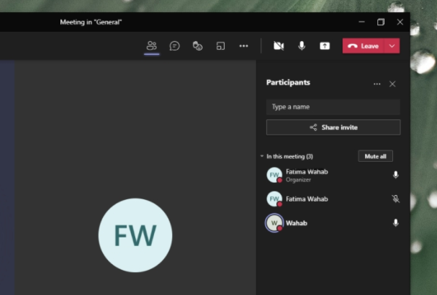
Meeting Procedures
Leave camera off (can have an effect on quality with large groups).
During the meeting leave microphone on mute (this will reduce feedback and interference).
If you have a question raise the electronic hand.
If you wish to speak unmute.
If possible leave questions to the end as your question may be covered in the presentation. You can put them in the meeting chat so that all attendees can view.
This information session will be recorded and available for viewing via the HVS page on the website.

Slide 4
Heavy Vehicle Services (HVS)
Heavy Vehicle Services seeks to improve productivity and economic growth for the transport industry whilst ensuring ongoing safety for all road users, asset protection and efficient and sustainable heavy vehicle access to Western Australia’s road network.
Via the issuance of permits, managing Restricted Access Vehicle (RAV) access, administering WA Heavy Vehicle Accreditation (WAHVA), providing a dedicated heavy vehicle help desk, providing input on national transport matters and through on-road transport compliance.
Educational approach to encourage voluntary compliance.

Slide 5
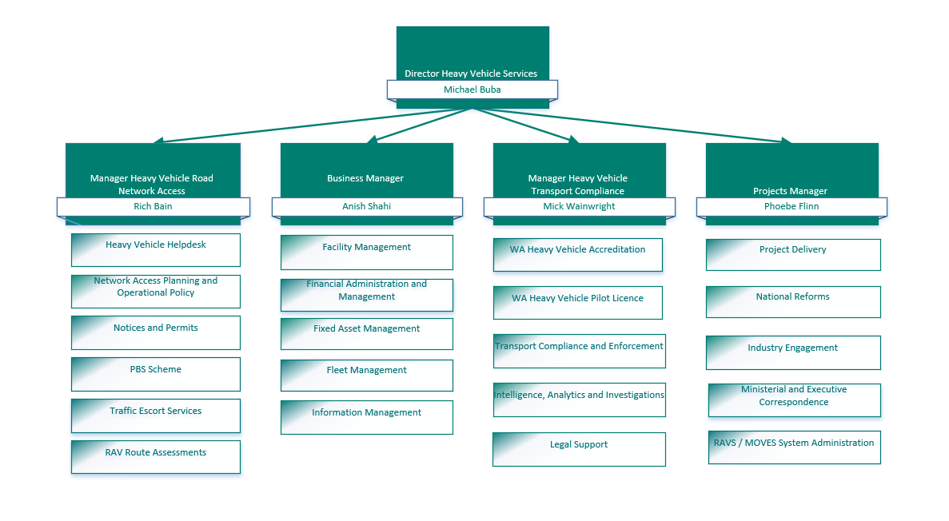
Heavy Vehicle Services (HVS)

Slide 6
Consultant
V
Auditor

Slide 7
Consultant
Definition:
  An individual or company who provide expert advice and/or services re implementation, design and ongoing support professionally, weather compensated or not, on all matters relating to an operators WAHVA

Slide 8
Auditor
Definition
  A person certified as a Heavy Vehicle Accreditation Auditor (HVA) by Main Roads, to undertake heavy vehicle accreditation audits.
  (External) - An external (3rd Party) auditor performs an audit, in accordance with specific laws or rules, of the financial statements of a company, government entity, other legal entity, or organisation, and is independent of the entity being audited. Users of these entities' financial information, such as investors, government agencies, and the general public, rely on the external auditor to present an unbiased and independent audit report.
Expectation of a WAHVA Certified Auditor within the WAHVA Scheme:
  As WAHVA certified auditors, you are required to be independent of any entity you audit, the integrity of the WAHVA Scheme relies on you as auditors to present an unbiased and independent audit report to Main Roads.

Slide 9
Revised
Documentation

Slide 10
Management Systems Standards (Module Standards)

Slide 11
Management System Standards
 Additions to Common Terminology
Consultant - Defined by Main Roads Heavy Vehicle Services as an individual or company who provide expert advice and /or services re implementation, design and ongoing support professionally, whether compensated or not, on all matters relating to an Operators WAHVA.
Management Systems - This means the Maintenance Management System, Mass Management System, Load Management System, Fatigue Management System and the Common Standards.
Qualified Person/s (re: vehicle maintenance) - This includes the following people:
  1) Trade qualified in-house mechanics/repairers/workshop employees and any person/s who are working under their supervision;
  2) any person/s who have had at least five years’ experience in the maintenance of heavy vehicles; and
  3) external registered suppliers.

Slide 12
Management System Standards
Amendments to the Standards – Removed as a WAHVA requirement
Removal of some criteria to eliminate duplication. Eg: Written instruction re managing the rollover risk of the vehicle from the Mass Management Module, as is already covered in the Dimension and Loading Management Module.
Common Standards 2.8 – Maintenance: Removed “who updates the service supplier list” (Preferred Supplier List).
Common Standards 4 – Internal Review: Removed all references to Quarterly Compliance Statements.
Maintenance Module – Maintenance Schedules and Methods 5.4: Removed Include a documented Table of Tolerances (ToT) and wear limits for major components and it must comply with at least the National Roadworthiness Guidelines

Slide 13
Management System Standards
 Amendments to the Standards – Existing Standard/Criteria Reworded and/or Moved
From: Common Standards: 2.6 - Have documented evidence of completed Internal Reviews and Quarterly Compliance Statements (must as a minimum include all relevant items from the form in the current Operator Guide). To: Common Standards and reworded: 2.8 - Record of completed Bi-annual (6 monthly) Internal Reviews (must as a minimum include all relevant items from the form in the current Operator Guide.
From: Maintenance Module 1.1 – To: Common Standards 2.8
- Vehicle make.
- Type of vehicle.
- Date of manufacture.
- Registration number.
- Vehicle Identification Number (VIN).
- Date added to the register.
- Date removed or sold from the fleet.
From : Mass Module 1.1 – To: Common Standards 2.8
- Vehicle make.
- Registration number.
- Vehicle Identification Number (VIN).
- Gross Vehicle Mass (GVM) rating.
- Gross Combination Mass (GCM) rating.
- Date added to the register.
- Relevant AMMS Permits number and expiry date.

Slide 14
Management System Standards
 Amendments to the Standards – Existing Standard/Criteria Reworded and/or Moved
Common Standards 2.8 reworded to:
  Type of vehicle.
  Registration number.
  Vehicle make.
  Year of manufacture.
  Date of last roadworthy.
  Vehicle Identification Number (VIN).
  Manufacturers Gross Combination Mass (MGCM) rating. (Only required for vehicles operating under the Mass Management Module)
  Aggregate Trailer Mass (ATM). (Only required for vehicles operating under the Mass Management Module)
  AMMS Permit Number.
  AMMS Permit Expiry Date
  Date added to the register.
  Date removed or sold from the fleet.

Slide 15
Management System Standards
 Amendments to the Standards – Existing Standard/Criteria Reworded
Common Standards: 2.8 All modules
From: Record of the training/induction provided.
To: Reworded to include the minimum requirements in each.
Common Standards: 2.8 Mass Module
From: “Verifies load plan/s quarterly ……..is not part of the loading plan.”
Reworded To: “Records verifying load plan/s quarterly …….. is not part of the loading plan.”
Common Standards: 2.8 Mass Module –
From:
  Registration details of the vehicles used in combination.
  AMMS permit number recorded per load/trip.
  The type/contents of the load carried.
  The masses, or the methodology used to determine axle weight compliance.
  Reworded To: Documentation providing an auditable link between:
  The registration details of the vehicles used in the combination.
  AMMS permit number recorded per load/trip.
  The type/contents of the load carried.
  The masses, or the methodology used to determine axle and gross weight compliance.
From: Common Standards – Workplace Conditions: 4.1 - Written instructions must detail the type of evidence to confirm that the vehicle ………... (this includes 2 up operations).
Reworded To: Written instructions must confirm that the vehicle ………. (includes 2 up operations).

Slide 16
Management System Standards
 Amendments to the Standards – Existing Standard/Criteria Reworded
Maintenance Module – Daily Check: 2.2
From: Brakes to ensure fully operational, adequately adjusted, and free of leaks.
Reworded To: Brakes to ensure fully operational, adequately adjusted, and free of leaks. All ABS, EBS, ESC and T-EBS plugs MUST be connected and Systems Operational if present..
Common Standards: 4 – Internal Review All references to “annual” Internal Reviews reworded to “bi-annual (6 monthly) at a minimum”.
Common Standards: 2.8 Fatigue Module
From: As a minimum trip records must record:
  Work time
  Breaks from driving
  Non-work time
  Drivers full name
  Date
  Start and finish times (trip sheets) for trips with details of any alterations ”.
Reworded To: As a minimum trip records must record:
  Work time
  Breaks from driving
  Non-work time
  Drivers full name
  Date
  Start and finish times (trip sheets) for trips with details of any alterations ”.
  Start and finish locations

Slide 17
Operator Guide and Sample Template Forms

Slide 18
Management System Standards
 Additions to Common Terminology
Consultant - Defined by Main Roads Heavy Vehicle Services as an individual or company who provide expert advice and /or services re implementation, design and ongoing support professionally, whether compensated or not, on all matters relating to an Operators WAHVA.
Management Systems - This means the Maintenance Management System, Mass Management System, Load Management System, Fatigue Management System and the Common Standards.
Qualified Person/s (re: vehicle maintenance) - This includes the following people:
  1) Trade qualified in-house mechanics/repairers/workshop employees and any person/s who are working under their supervision;
  2) any person/s who have had at least five years’ experience in the maintenance of heavy vehicles; and
  3) external registered suppliers.
 Other Amendments
All references to “annual” Internal Reviews reworded to “bi-annual (6 monthly)” as a minimum.
Removed all references to Quarterly Compliance Statements.
Fatigue Management Policy Statement template form: - Amended to include the requirements of Fatigue Module Standard 3.1, 3.2 & 3.3.
Statement of Responsibilities template forms: - New forms for each of the modules & Common Standards, which list the minimum responsibility requirements for each with options to select who is tasked with these.

Slide 19
WAHVA Business Rules

Slide 20
WAHVA Business Rules
 Additions to Common Terminology
Qualified Person/s (re: vehicle maintenance) - This includes the following people:
  1) Trade qualified in-house mechanics/repairers/workshop employees and any person/s who are working under their supervision;
  2) any person/s who have had at least five years’ experience in the maintenance of heavy vehicles; and
  3) external registered suppliers.
 Other Amendments
Fees and Charges: Expanded with an explanation of how accreditation fees can be paid and what is required.
Random Compliance Checks: Removal of paragraphs referencing quarterly compliance statements.
EXISTING ACCREDITATION HOLDERS – Renewal Requirements:
  Expanded with an explanation of the HVS products an operator is and isn’t eligible for once their accreditation has expired and the effect on their Anniversary date.

Slide 21
Where To From Here?

Slide 22
WA Heavy Vehicle Accreditation (WAHVA) Review - SRG?
SRG was established late 2019 – with the first meeting held December 2019.
The SRG meet on an as needed basis through-out 2020.
The SRG are made up of various industry representatives who are:
  Kathleen Janissen - WAHVA Auditor
  Mal Southern - Zenith Low Loaders
  Glen Kendall - Kendall Trucking
  Samantha Cox - Arizona Haulage
  Grant Robbins - Kulin Transport
  Jason Millar - WAHVA Auditor
  Tony York - Yorks Anamenka (Anamenka Farms)
        Proxy - Trevor Whittington - WAFARMERS
  Jason Walters – Transport Workers Union

Slide 23
WA Heavy Vehicle Accreditation (WAHVA) Review - SRG?
In 2021 – the group did not meet due to either not having a quorum, HVS resource availability and or no new items to discuss. The group have not met since.
The following recommendations are yet to be completed / fully investigated and are what HVS will be progressing in line with the RAVS / MOVES Replacement Project and Implementation of the Heavy Vehicle Monitoring Sites (NCIS):
  Develop and implement categories for Operators #6
  Develop and implement risk levels and incentives for Operators #7
  Update the roadworthiness form and process #2
  Review the incident investigation process and link to accreditation status #18

Slide 24

Questions

Slide 25
Thankyou

